Slide 1
Criminal Justice Unit 4
5th and 6th Amendments

Slide 2
Pre-unit quiz
What does the 5th amendment protect us from
What does the 6th amendment protect us from
What is double jeopardy
What happens at a preliminary hearing
Why is an public trial important

Slide 3
5th Amendment
No person shall be held to answer for a capital crime, or otherwise infamous crime, unless on a presentment or indictment of a grand jury, except in cases arising in the land or naval forces or in the militia, when in actual service in time of war or public danger; nor shall any person be subject for the same offense to be twice put in jeopardy of life or limb; nor shall be compelled in any criminal case to be a witness against himself, nor be deprived of life, liberty or property without due process of law; nor shall private property be taken for public use without just compensation.

Slide 4
5th Amendment
Says
No person shall be held to answer for a capital, or other wise infamous crime unless on a presentment or indictment of a grand jury
Means:
Nobody can be put on trial for a very serious crime, unless a group of people called a grand jury first decide there is enough evidence

Slide 5
Grand Jury
Grand jury determines if there is enough evidence for a person to stand trial
If the grand jury determines there is enough evidence they issue an indictment
All federal capital cases have to use grand juries, states don’t have to use grand juries (about ½ do) they use preliminary hearings, if there is enough evidence they issue an information

Slide 6
5th Amendment (con)
Says:
Except in cases arising in the land or naval forces, or in the militia, when in actual service in time of war or public danger
Means: people in the military can be put on trial with out indictment or grand jury if they commit a crime during war or national emergency

Slide 7
5th Amendment (con)
Says: nor shall any person be subject for the same offense to be twice put in jeopardy of life or limb
Means: if someone is put on trial for a crime and the person is found guilty or not guilty they may not be put on trial again for the same charges

Slide 8
Double Jeopardy
Protects citizens from being tried twice for the same offense
Prevents the government from giving a defendant more than one punishment for the same offense
Defendants can be found not guilty in criminal court and then tried in civil court
In civil court you don’t face loss of liberty

Slide 9
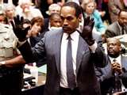
Double Jeopardy
O.J. was found not guilty in criminal court but guilty in civil court

Slide 10
5th Amendment (con)
Says: nor shall be compelled in any criminal case to be witness against themselves
Means: the government can not make someone testify against themselves. Witness can be compelled to testify, but they can plead the 5th if the information would incriminate them

Slide 11
Self Incrimination
This applies to criminal, civil, grand jury, preliminary hearings, federal and state
Judges instruct the jury not to assume guilt because they evoke the 5th
This applies to a witness as well as defendant
This part of the amendment helped establish the Miranda warning

Slide 12
5th Amendment (con)
Says: nor be deprived of life, liberty or property, without due process of law
Means: the government can not take away someone's life, liberty or property without following a series of steps and laws (procedural and substantive) these rights are called due process

Slide 13
5th Amendment (con)
Says: nor shall Private property be taken for public use, without just compensation
Means: the government cannot take your property without paying what it is worth

Slide 14
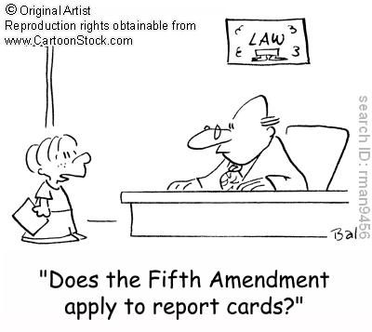
Due Process Clause
Procedural: the process has to be fair
Substantive: the law has to be fair

Slide 15
Sixth Amendment
In all criminal prosecutions, the accused shall enjoy the right to a speedy and public trial, by an impartial jury of the state and district wherein the crime shall have been committed, which district shall have been previously ascertained by law, and to be informed of the nature and cause of the accusation; to be confronted with the witness against him; to have compulsory process for obtaining witnesses in his favor, and to have the assistance of counsel for his defense

Slide 16
Sixth Amendment (con)
Says: In all criminal persecutions, the accused shall enjoy the right to a speedy and public trial
Means: a trial cannot extend past the time set by each state and the trial must conducted in a court that is open to the public

Slide 17
Speedy Trial
The speedy trial act of 1974 was designed to ensure that no one would be held for a long period of time without having their day in court
In general the trial should start within 70 days of the indictment
This law was meant to prevent the prosecution from keeping a person locked away until they would just accept a plea bargain in order to get out of jail

Slide 18
Sixth Amendment (con)
Says: by an impartial jury of the state and district wherein the crime shall have been committed, which district shall have been previously ascertained by law
Means: The jurors must not be prejudiced against the defendant or the crime they are accused of, each lawyer has the opportunity to question the jurors and dismiss potential jurors they feel maybe prejudice

Slide 19
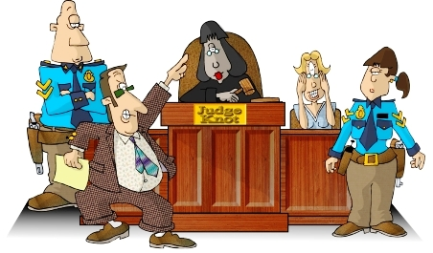
Sixth Amendment (con)
Means (con): the trial must be held in the area where the crime was committed, the jurisdiction (place where the trial will be held) is decided before the case starts by state or federal congress

Slide 20
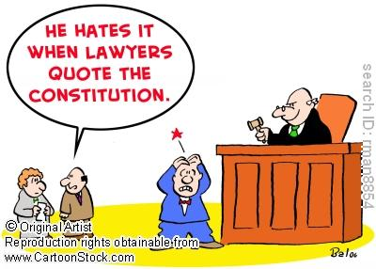
Place of the Trial
The accused is tried in the district of the indictment
There can be a request for a change of venue by either the defense or the prosecution

Slide 21
Impartial Jury
The jury has to represent a cross section of the community where the crime took place, and the jurors must be unbiased (They don’t have strong feelings one way or another about the crime or the person)

Slide 22
Jury selection
Attorneys have the right to peremptory challenges (can question potential jurors and dismiss any they feel may be bias)
They can exclude with cause or without cause
Each side has a set number of exclusions without cause (usually 3)
This process is called Voir Dire

Slide 23
Sixth Amendment (con)
Says: and to be informed of the nature and cause of the accusation; to be confronted with the witnesses against him
Means: the defendant has the right to know what they are being charged with and why they’re being held in jail and the right to face the person who is saying they committed a crime and the right to ask them questions

Slide 24
Notice of accusation
The defendant must be made aware of the charges against them at an initial appearance
Arraignment (accused hears the charges and their rights, bail can be set at this time)
The constitution does not specify how long they can be held without knowing the charges, the Supreme Court has ruled that it must be promptly (about 48 hours) from the booking

Slide 25
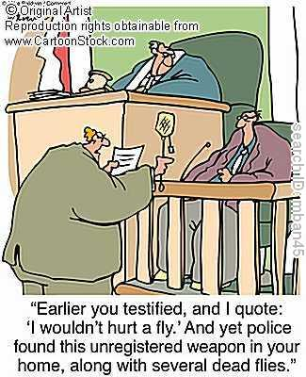
Confrontation
Defendants have the right to face their accusers, this gives the defense the ability to cross-examine someone who is testifying against them

Slide 26
Sixth Amendment (con)
Says: to have compulsory process for obtaining witnesses in his favor, and to have the assistance of counsel for his defense
Means: the defendant has the right to force anyone to testify, the court will issue a subpoena
They have the right to an attorney, if they cannot afford one, one will be assigned to their case

Slide 27
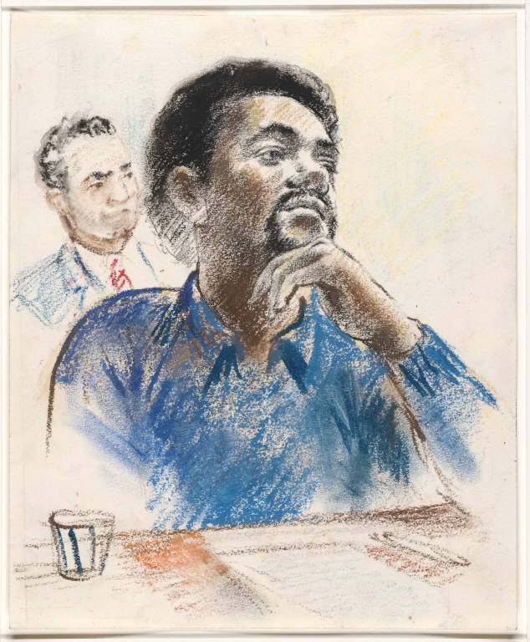
Compulsory Process
Defense can call witness for that would help in their defense
The prosecution has to have the opportunity to question each witness the defense calls

