Slide 1
Criminal Justice Unit 1
Crime and Criminal Justice

Slide 2
Criminal Justice
Is like a pendulum, it swings from less rights for people to more rights for people
based on the attitudes of society

Slide 3
Components of CJS
THREE COMPONENTS
police: maintain order, enforce criminal law
Courts: determines if laws have been broken and what punishment is necessary
Corrections: they remove offenders from society or try to rehabilitate the anti social behavior

Slide 4
CJS
Is designed to control, manage, restrain or direct the behavior of society
This is accomplished by: creating, interpreting, and enforcing laws and punishing law breakers

Slide 5
CJS
All three branches of Government are involved with CJS
Legislative: creates the law, and provides funding
Executive: gives law enforcement the authority to make arrests
Judicial: interprets the law and provides the jurisdiction to hear cases

Slide 6
CJS Cost
We spend over $212 billion dollars a year
Employs over 2.3 million people
Over 7 million people are controlled by the CJS in one way or another
With about 2 million behind bars

Slide 7
CJS Funnel
Explains how the number of crimes committed compared to the number of arrests and finally the number of people under control of the CJS

Slide 8
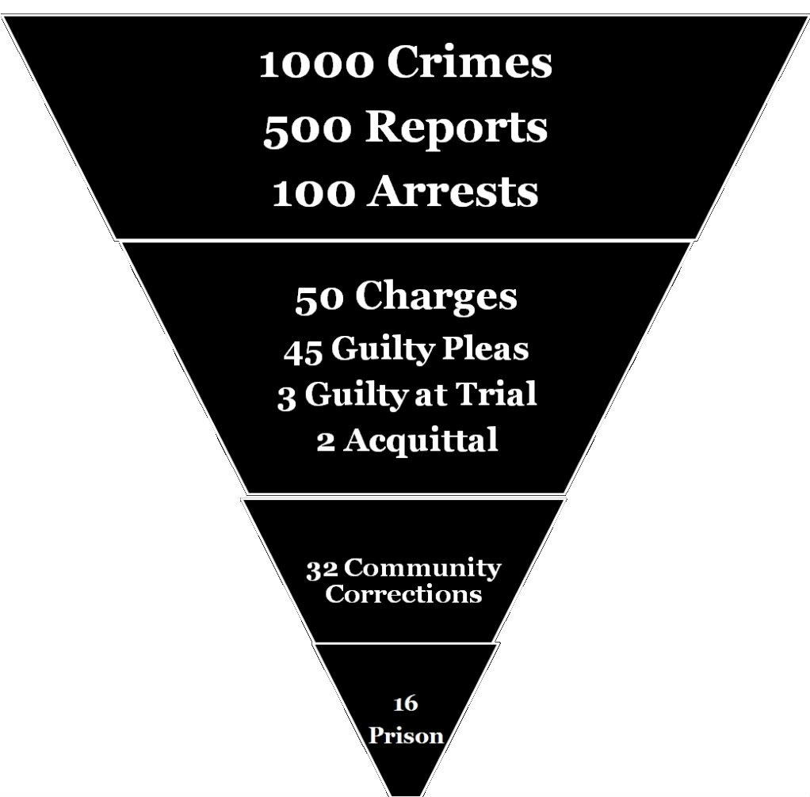
CJS Funnel

Slide 9
Wedding Cake Model of Justice
Divides the CJS into 4 layers that demonstrates how the CJS uses its resources
Top layer: celebrated cases, these cases get most of the attention from the CJS and get the best resources available ex. Aaron Hernadez, George Zimmerman, Serial Killers
Second layer: serious felonies such as: murder, rape or robberies and burglaries committed by experienced offenders

Slide 10
Wedding Cake Model of Justice
Third layer: less serious felonies, committed by first time offenders or involving people who know each other
Fourth Layer: misdemeanors, small crimes handled by the lower courts, little attention is given to this layer but is the largest number of crimes

Slide 11
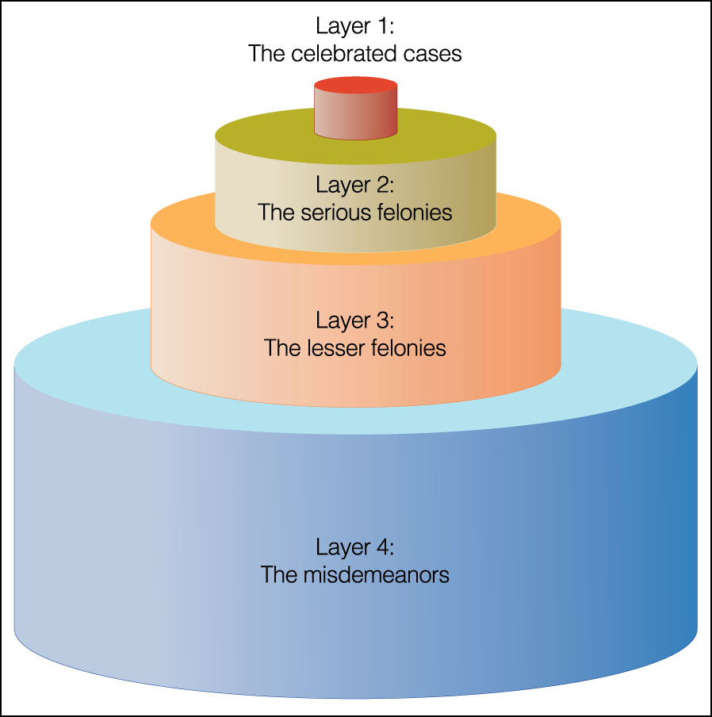
Wedding Cake Model of Justice

Slide 12
Perspectives on Justice
Many different philosophies or beliefs (perspectives) are held about how to control crime and keep our streets safe

Slide 13
Perspectives on Justice (con)
Crime control: protection of society should be done through harsh punishments that act as a deterrent to crime
Believes criminals make a decision to commit crime based on a risk reward system
Criminals have to believe they will be swiftly caught and harshly punished to be an effective deterrent

Slide 14
Perspectives on Justice (con)
Rehabilitation: sees crime as an expression of frustration and anger created by social inequality that can be controlled by giving people the means to improve their life, they feel the criminals are the victims and they need to be treated not just locked away. They need to be shown another way to support them selves so they can become productive members of our society

Slide 15
Perspectives on Justice (con)
Due Process: emphasizes individual rights and constitutional safeguards against arbitrary or unfair judicial or administrative proceeding
CJS must provide fair and equal treatment for all accused of crimes
They would rather have a guilty person go free than to violate individuals rights

Slide 16
Perspectives on Justice (con)
Nonintervention: believes that justice agencies should limit their involvement with criminal defendants
They feel once someone is labeled as a criminal they will live up to that label
They feel victimless crimes should be legalized, nonviolent offenders should be removed from prisons and given treatment

Slide 17
Perspectives on Justice (con)
Justice: all people should receive the same treatment, discretion should be removed from courts and everyone gets the same sentence for the same crime
Truth in Sentencing Laws, mandatory sentencing for crimes

Slide 18
Perspectives on Justice (con)
Restorative Justice: purpose of justice is to restore offenders back into society through reconciliation rather than punishment
The criminal and the victim should get together so the offender can make amends and then reenter into society

Slide 19
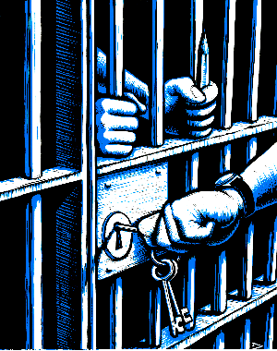
Ethics in CJS
Ethics are so important in the CJS because they can deprive you of life and liberty

